Slide 1
Historical Fiction
Topic: Introduction to Historical Fiction
Unit Title: Exploring Genres: Understanding Historical Fiction Lesson Focus: Identifying and understanding the key elements and conventions of Historical Fiction through discussion and real-life examples.

Slide 2
MYP Framework/ Unit details
Key Concept: Communication
Related Concepts: Setting, Point of View
Global Context: Orientation in Time and Space (exploring how historical events influence stories)

Slide 3
Statement of inquiry: Stories set in the past help us communicate ideas about history, society, and human experiences. (Key words can be given from this and students can make their own SOI first)
Inquiry Questions
Factual: What is Historical Fiction? What are the conventions of Historical Fiction?
Conceptual: How does Historical Fiction help us understand the past?
Debatable: Should Historical Fiction stick closely to real facts or have creative freedom?

Slide 4
Lesson objective
I will be able to:
-Identify the key elements of Historical Fiction.
-Explain how Historical Fiction differs from other genres.
-Connect real historical events to fictional stories.

Slide 5
Approaches to Learning (ATL)
Thinking Skills: Critical and creative thinking
Research Skills: Finding and interpreting information
Communication Skills: Sharing ideas and opinions clearly

Slide 6
Task: Read the story:
Title: The Hidden Letter
In 1942, twelve-year-old Anya found a secret letter under a floorboard. It spoke of escape, bravery, and hope. Holding it close, she imagined the writer’s journey through war-torn streets. Years later, she’d tell that forgotten story—reminding everyone that even whispers from the past can change the future.
Which type of fiction does this story belong to and why? Note down the keywords related to the genre.

Slide 7
Prior Knowledge Test (5 mins, pairs) Questions:
What are the essential components of a story?
Mention 2 elements that make a story interesting.
What do you understand by “Historical Fiction”?
How does Historical Fiction differ from other types of stories?

Slide 8
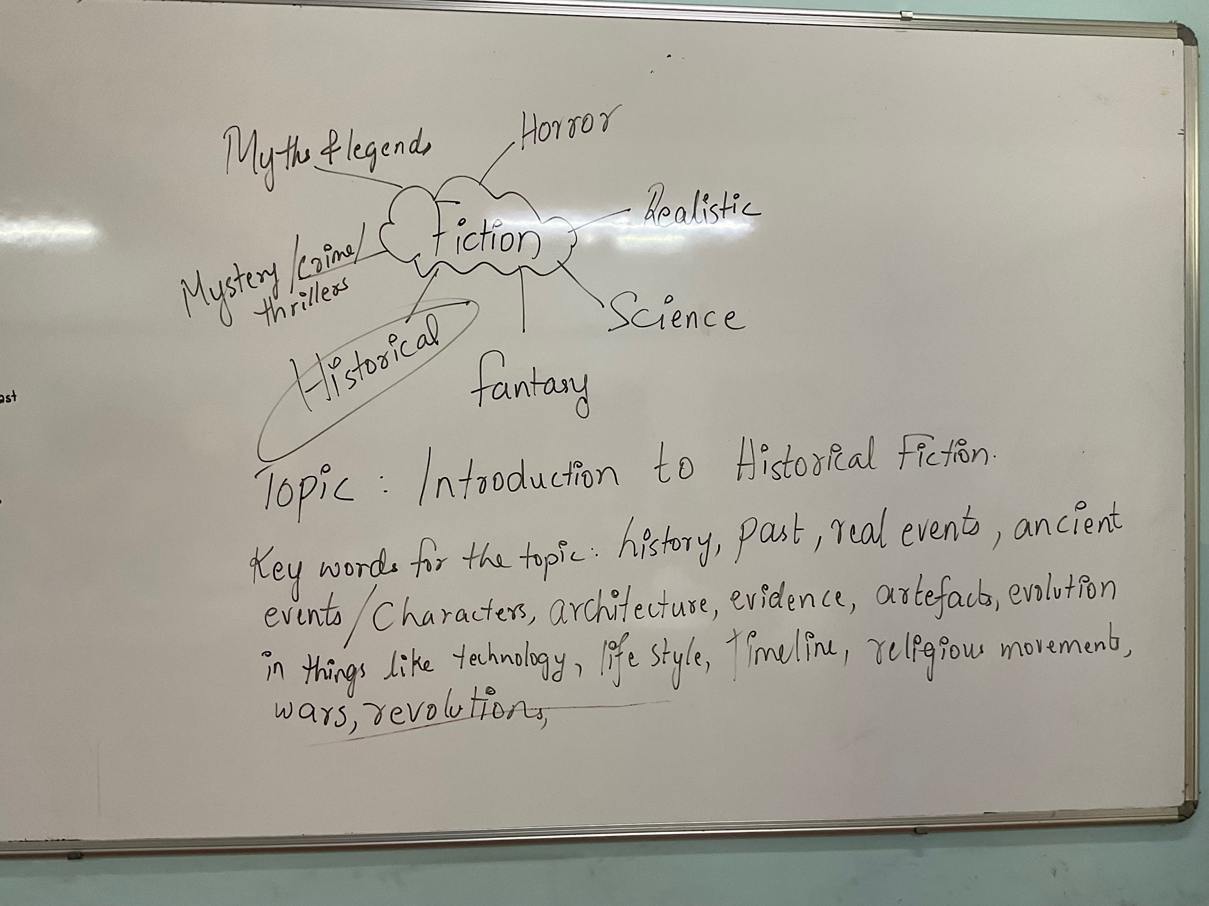

Slide 9
Explanation
Historical Fiction: A genre where fictional stories are set in real historical times with real or imaginary characters.
Quick analogy: Compare a pure history book vs. a historical fiction novel.
History book = facts, dates, real people.
Historical Fiction = adds imaginary characters and dialogue to bring the past alive.
Example: “If I write a story about my great-grandfather during WWII but invent his conversations — that’s Historical Fiction.”

Slide 10
Essential elements of Historical Fiction.
Conventions of Historical Fiction
1. Realistic Historical Setting
The story takes place in a real historical time and place (e.g., Ancient Rome, Colonial India, World War II).
Details about clothes, food, buildings, transport, language, and customs are accurate for that time.
2. Blend of Fact and Fiction
The main characters or plot may be made up, but they live through real historical events or meet real historical figures.
Writers often include real events (like a war or revolution) that shape the plot.
3. Authentic Characters
Characters speak, behave, and think in ways that match their time period.
They might face problems that people really faced back then (like social class, war, disease, limited rights).

Slide 11
4. Descriptive Language
The author uses descriptive details to help the reader imagine the past.
Sensory details (what people saw, heard, smelled) bring the setting to life.
5. Historical Accuracy
Writers research the time period so they don’t include things that didn’t exist yet.
For example: no cell phones in Victorian England!
6. Themes Linked to History
Stories may explore how people struggled or survived, or how historical events changed people’s lives.
Common themes: courage, injustice, freedom, loyalty.
7. Author’s Note (sometimes)
Many historical fiction books include a note at the end explaining what was real and what was fictional.

Slide 12
Graphic organizer showing Fact vs Fiction.
FACT: Real events True dates Actual people (historical figures) Evidence and documents Based on real research | OVERLAP (HISTORICAL FICTION): Real setting in the past Real events + imaginary stories Real people may appear but interact with fictional characters Factual details add realism to invented stories | FICTION: Made-up characters Imaginary dialogues Invented plots Creative twists Author’s imagination

Slide 13
Assessment for Learning (AfL)
Task: Revise the elements of historical fiction.
Class discussion or journaling moment: “What makes historical fiction powerful or challenging to write?”

Slide 14
Plenary: 3 minutes
Activity: Exit Ticket: Each student writes one new thing they learned and one question they still have about Historical Fiction.

